Slide 1


“Mid Term Project – Chat Application”
Submitted by: Bammidi Vihar
Submission type : Individual
Name: Bammidi Vihar
Batch : Axis Bank Fintech Batch 12
LMS Id : 8309663483
Program : Axis Bank Fintech Batch 12
Date: 31/05/2023

Slide 2

Table of contents
Introduction
UML Diagram
Project Overview
Architecture Design
User Interface Design
Use Effect
Back-end Development
Front-end Development
Testing
Conclusion
Future Work
References
Appendices and flow of the project and some of the Logics for what I did
Deployment

Slide 3
Introduction
Introduction of Chat project:
develop a chat application that will allow users to communicate with
each other in real-time. The application will be available on both desktop and mobile devices,
and will be easy to use and navigate. The primary purpose of the chat application is to provide a
simple and effective way for users to communicate with each other.
Problem Statement
Our project aims to address the limitations of existing chat applications and enhance the user experience.
Many chat applications lack essential features and face challenges in terms of scalability and user engagement
Purpose of our project
The purpose of our chat application project is to create a comprehensive solution that caters to the evolving communication needs of users..
Scope of Project
Our project will focus on developing a chat application for mobile and web platforms.
The application will support real-time messaging, file sharing, group chats, and other essential features.
Integration with popular communication platforms and services will be considered to provide a unified experience.

Slide 4
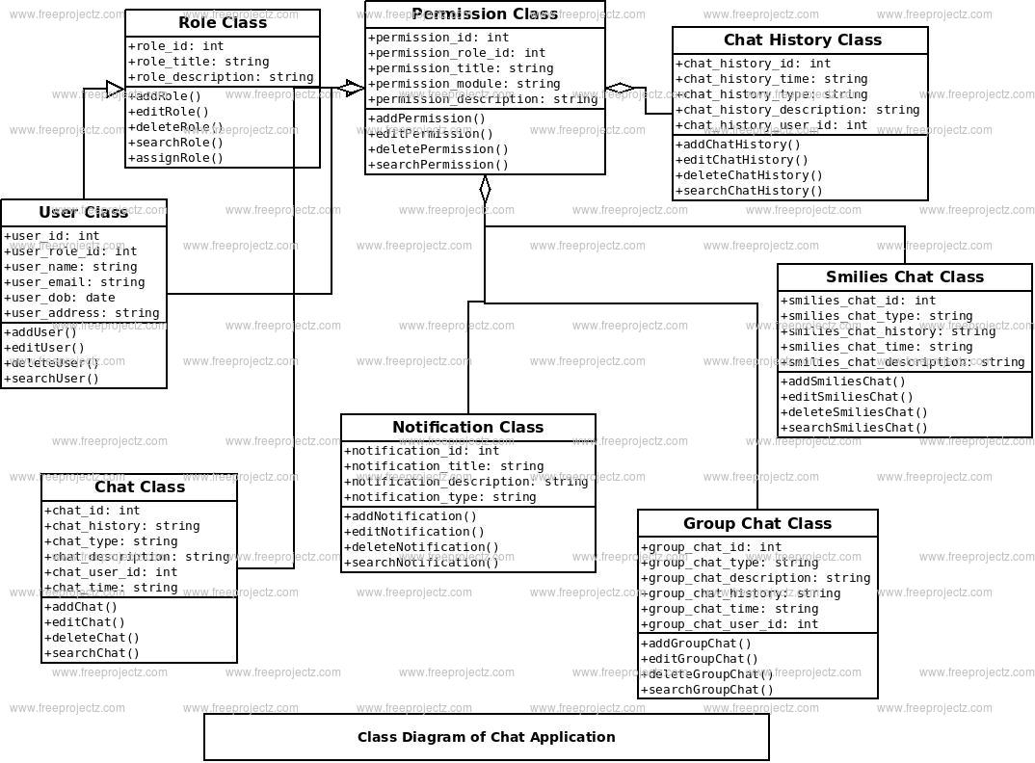
UML Class Diagram

Slide 5
Project Overview
Features:
Real-time messaging: Users can exchange messages instantly, enabling seamless and quick communication.
Group chats and channels, Profile Pic: The application allows users to create and participate in group conversations or channels for teamwork and community building, Users can keep their profile pic while signing up
Emojis and stickers: A collection of expressive emojis and stickers are available to add fun and emotions to conversations.
(Press the win+; button to get access) for emojis
Notification and Report: Users receive timely notifications and can report a user through mail
Search users and view profile: Users can search other users to access the chat and they can view their own profile as well as others
Background Images and Lottie Typing: You will find different background images for single chat one and group chat one and users when typing gets the Lottie typing for other users
Logout and Login: Users can login and logout

Slide 6
Project Overview
Functionality:
User registration and authentication: Users can create accounts and securely log in to access the chat application.
Contact management: Users can manage their contacts, create friend lists, and search for other users.
Chat history and synchronization: Messages and chat history are synced across devices, ensuring a seamless user experience.
Message search and filtering: Users can search for specific messages or apply filters to easily find relevant conversations.
Privacy and security: Robust measures are implemented to protect user data, encrypt communications, and prevent unauthorized access and the password that stores in the data base will be in code format so password will be protected
Technology Stack:
Front-end: HTML, CSS, JavaScript, React.js
Back-end: Java, Spring boot, Java Script, Node.js
Database: MongoDB
Real-time communication: Socket.io
Cloud structure for pictures: Cloudinary

Slide 7
Architecture Design
Front-End Design:
User Interface (UI): The front-end design focuses on creating an intuitive and visually appealing user interface.
Responsive Design: The application is designed to adapt seamlessly to different screen sizes and devices.
Interactive Components: UI components such as chat bubbles, message input forms, and contact lists are designed for optimal user interaction.
Back-End Design:
Server Infrastructure: The back-end consists of servers that handle the logic, processing, and storage of data.
API Development: RESTful APIs are designed to enable communication between the front-end and the back-end.
Business Logic: The back-end handles user authentication, message routing, notifications, and other essential functionalities.
Database Design:
Data Storage: The application utilizes a database system to store user profiles, chat history, and other relevant data.
Data Modeling: The database is designed with appropriate tables, schemas, and relationships to ensure efficient data management.

Slide 8
Architecture Design
Communication and Integration:
Real-Time Communication: Socket.io (or other preferred technologies) facilitates real-time messaging and notification updates.
Third-Party Integration: APIs of external services may be integrated to provide additional features, such as file storage or authentication.

Slide 9
User Interface Design
Wireframes:
Wireframes depict the basic structure and layout of the chat application's user interface.
They outline the placement and arrangement of key elements such as chat windows, input fields, and navigation menus.
User Flows:
User flows demonstrate the step-by-step journey a user takes while using the chat application.
They illustrate the process of starting a chat, sending messages, joining groups, and accessing additional features.
Design Principles:
Simplicity: The user interface design emphasizes simplicity and ease of use to ensure a smooth chat experience.
Clear Communication: Visual cues, icons, and labels are employed to effectively convey information and actions.
Responsive Design: The chat application adapts seamlessly to various screen sizes, including mobile and desktop devices.
Intuitive Interactions: User interactions, such as sending messages, joining groups, and accessing settings, are designed to be intuitive and user-friendly.
Visual Appeal: The chat application incorporates appealing visual elements, including emoticons, color palettes, and appropriate use of whitespace.

Slide 10
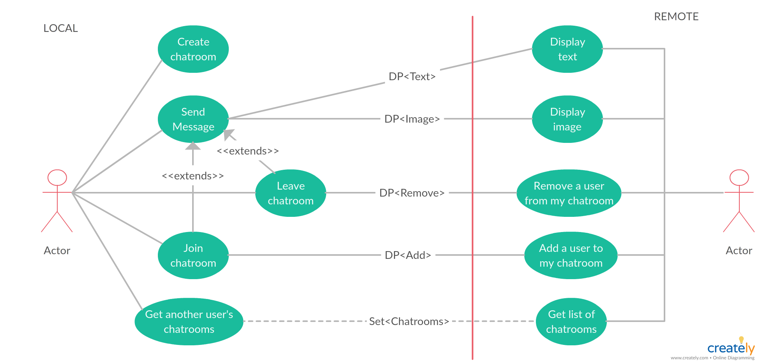
Use Effect

Slide 11
Back-end Development
API
URL url=new URL(http://example.com/api/users/register //set url for request
HttpURLConnection connection = (HttpURLConnection) url.openConnection(); // Open a connection
connection.setRequestMethod("POST"); // // Set the request method to POST
// Enable input and output streams
connection.setDoOutput(true);
// set the request body
String requestBody = "{\n" +
" \"username\": \"example_user\",\n" +
" \"password\": \"example_password\",\n" +
" \"email\": \"example@example.com\"\n" +
"}";
// Get the Response code
int responseCode = connection.getResponseCode();
System.out.println("Response Code: " + responseCode);

Slide 12
Back-end Development
Database Schema:
The chat application utilizes a mongo db database to store and manage data.
The database schema is designed to accommodate user profiles, chat history, contacts, and other relevant information.
Scalability and Performance:
The back-end architecture is designed to handle increasing user demands and scale effectively.
Techniques like load balancing, caching, and horizontal scaling are implemented to ensure optimal performance and responsiveness.
Security and Authentication:
The back-end implements secure authentication mechanisms, such as JWT (JSON Web Tokens) or OAuth, to verify user identities and protect against unauthorized access.
Encryption techniques, like SSL/TLS, are employed to secure data transmission and protect sensitive information.

Slide 13
Front-end Development
Framework or Library:
Chakra UI, a highly customizable and accessible component library for React, is utilized for designing the user interface of the chat application.
Chakra UI provides pre-built, styled components such as buttons, input fields, and modals, allowing for faster and consistent development.
User Interface Components:
Chat Bubbles: Designed using Chakra UI components, chat bubbles display incoming and outgoing messages with appropriate styling
Message Input Form: Chakra UI input components are utilized for creating the form where users can type and send messages.
Contact Lists: Chakra UI provides components for creating visually appealing and interactive contact lists, displaying profile images.
Notification and Report and view profile: Chakra UI provides components for creating visually appealing and interactive mail for reporting, real time colour changing notification, and a eye icon to view profile

Slide 14
Front-end Development
React Components:
React components are used to modularize the application's UI elements, enabling reusability and easy maintenance.
Components like ChatWindow, MessageList, and ContactList are implemented to structure the chat application's user interface.
Styling and Customization:
CSS-in-JS techniques are employed, allowing for styling and customization of UI components using inline or external CSS.
Chakra UI provides a theming system that facilitates consistent styling and easy customization across the chat application.

Slide 15
Integration and Testing
API Testing with Postman:
Postman, a popular API testing tool, is utilized to validate the functionality of API endpoints, such as sending and retrieving messages.
Postman allows sending various types of HTTP requests (GET, POST, PUT, DELETE) to the API and analyzing the responses.
Custom headers, query parameters, and request bodies can be set in Postman to simulate different scenarios during testing.
Unit Tests:
Unit tests are conducted to verify the correctness of individual components or modules in isolation.
Testing frameworks like JUnit are used to write and execute unit tests for functions, classes, and utility methods.
Unit tests focus on verifying the expected behavior of specific code units and handling edge cases.

Slide 16
Integration and Testing
Integration Tests:
Integration tests are performed to assess the proper integration and interaction between different components or services.
These tests verify that various modules work together as expected, including the communication between the front-end and back-end.
Testing frameworks like React Testing Library or Spring Boot Test can be utilized for integration testing.

Slide 17
Conclusion
Main Features:
Real-time Messaging: The chat application enables users to exchange messages in real-time, providing instant communication.
User Authentication: Secure user authentication is implemented to ensure only authorized users can access the application.
Group Chats: Users can create or join group chats, facilitating collaboration and communication among multiple participants.
Notifications: Users receive notifications for new messages, ensuring they stay updated even when the application is not active.
Functionality:
Registration and Login: Users can create accounts and securely log in to access the chat application.
Friend Connections: Users can add friends or contacts to their network, enabling direct messaging and easy communication.
Search and Filter: Users can search for specific contacts or messages and filter chat conversations based on various criteria.
Message History: The chat application stores message history, allowing users to view past conversations and scroll through messages.

Slide 18
Conclusion
Technology Stack:
Front-End: The chat application's front-end is developed using React.js, utilizing Chakra UI for intuitive and visually appealing user interface components.
Back-End: The back-end is built with Spring Boot, a Java-based framework, and node.js a java Script framework providing robust and scalable server-side functionality.
Database: The application uses a relational database management system Mangodb for storing user data, messages, and chat history.
API Testing: Postman is employed to test and validate the APIs, ensuring seamless communication between the front-end and back-end.
Development Challenges:
Real-Time Communication: Implementing real-time messaging required overcoming challenges related to handling concurrent connections and ensuring message delivery.
Scalability: Designing the application to handle a growing number of users and high message traffic posed challenges in terms of performance and scalability.
Security: Ensuring secure user authentication and protecting user data from unauthorized access required careful implementation of security measures.

Slide 19
Conclusion
Overcoming Challenges:
Thorough planning and architectural design helped address real-time communication challenges and implement scalable solutions.
Extensive performance testing and optimization techniques were applied to ensure the application could handle increased user load.
Robust authentication mechanisms, encryption protocols, and best practices were implemented to ensure the security of user data.

Slide 20
Future Work
Future Development
There are few areas of development required in my Chatty application:
Time Stamp: Right now the user can send messages and receive but they cant know at what time they sent so in time I am sure I will be able to improve this
Sending Pictures and videos: Right now User can do live chat but he cant send pictures and videos which can be improved in time
Update profile pic: Right now User can only keep his profile pic and his profile once at the time of Signup but in time I will improve this part to make it better.
Block User: Right now user can report abusive language or inappropriate words or hate symbols through mail with the mail icon then after reviewing the chat chatty app creator (i.e.., Me) can take the action but in time I will implement a block user functionality so a person can block a user if he doesn’t wish to chat with him.
These are the future requirements that I intend to make.

Slide 21
References
Programming Languages and Frameworks:
Java: Official Java Documentation (https://docs.oracle.com/javase/)
JavaScript: MDN Web Docs (https://developer.mozilla.org/en-US/docs/Web/JavaScript)
front-End Libraries and Tools:
React.js: React Documentation (https://reactjs.org/docs/)
Chakra UI: Chakra UI Documentation (https://chakra-ui.com/docs/getting-started)
Back-End Framework and Tools:
Spring Boot: Spring Boot Documentation (https://spring.io/projects/spring-boot)
Spring Framework: Spring Framework Documentation (https://spring.io/projects/spring-framework)
Spring Data JPA: Spring Data JPA Documentation (https://spring.io/projects/spring-data-jpa)
Database Management System:
MongoDB: MongoDB Documentation (https://docs.mongodb.com/)
Additional Resources and References:
Online tutorials, blogs, and forums:
Stack Overflow (https://stackoverflow.com/)
Medium (https://medium.com/)
Dev.to (https://dev.to/)

Slide 22
Appendices
For home page
const Homepage = () => {
const history = useHistory();
useEffect(() => {
const userInfo = JSON.parse(localStorage.getItem("userInfo"));
if (!userInfo) { history.push("/") };
}, [history]);
Toast
toast({
title: "Error Occured!",
description: "Failed to Load the chats",
status: "error",
duration: 5000,
isClosable: true,
position: "bottom-left",
});

Slide 23
Appendices
To change Notification colour
useEffect(() => {
// Check if there are any unread notifications
if (notification.length > 0) {
setIsNotificationReceived(true);
setBellIconColor("green.500"); // Set the bell icon color to red
} else {
setIsNotificationReceived(false);
setBellIconColor("red.500"); // Set the bell icon color back to its original variant
}
}, [notification]);
const handleNotificationClick = () => {
setIsNotificationReceived(false);
setBellIconColor("red.500"); // Set the bell icon color back to its original variant
};

Slide 24
Appendices
The Style and logic of notification
<MenuList paddingLeft={2}>
{!notification.length && "No new Messages"}
{notification.map((notif) => (
<MenuItem
key={notif._id}
onClick={() => {
setSelectedChat(notif.chat);
setNotification(notification.filter((n) => n !== notif));
}}
>
{notif.chat.isGroupChat ? `New Message in ${notif.chat.chatName}` : `New Message from ${getSender(user, notif.chat.users)}`}
</MenuItem>
))}

Slide 25
Appendices
Password bycrypt protected logic
@Autowired
private PasswordEncoder passwordEncoder;
public void registerUser(String username, String password) {
String encodedPassword = passwordEncoder.encode(password);
// Save the encodedPassword to the user repository or perform other actions
}
***************************---------------------------*************************************
@Bean
public PasswordEncoder passwordEncoder() {
return new BCryptPasswordEncoder();

Slide 26
Appendices
Backend Connection server logic
@SpringBootApplication
@EnableWebSocket
@EnableWebSocketMessageBroker
public class BackendApplication implements WebSocketConfigurer, WebSocketMessageBrokerConfigurer {
public static void main(String[] args) {
SpringApplication.run(BackendApplication.class, args);
}
@Override
public void registerWebSocketHandlers(WebSocketHandlerRegistry registry) {
registry.addHandler(socketHandler(), "/socket").setAllowedOrigins("http://localhost:3000")
.addInterceptors(new HttpSessionHandshakeInterceptor());
}

Slide 27
Appendices
Backend Connection server logic
@Bean
public SocketHandler socketHandler() {
return new SocketHandler();
}
@Override
public void configureMessageBroker(MessageBrokerRegistry registry) {
registry.enableSimpleBroker("/topic");
registry.setApplicationDestinationPrefixes("/app");
}
@Bean
public ServletServerContainerFactoryBean createWebSocketContainer() {
ServletServerContainerFactoryBean container = new ServletServerContainerFactoryBean();
container.setMaxTextMessageBufferSize(8192);
container.setMaxBinaryMessageBufferSize(8192);
return container;
}
}

Slide 28
Appendices
Backend Connection server logic
@RestController
@RequestMapping("/")
class HomeController {
@GetMapping
public String home() {
return "Get along 12th man army RCB";
}
}
@RestController
@RequestMapping("/api")
class ApiController {
@GetMapping("/user")
public String getUser() {
return "User API";
}

Slide 29
Appendices
Backend Connection server logic
@RestController
@RequestMapping("/")
class HomeController {
@GetMapping
public String home() {
return "Get along 12th man army RCB";
}
}
@RestController
@RequestMapping("/api")
class ApiController {
@GetMapping("/user")
public String getUser() {
return "User API";
}

Slide 30
Github link
https://github.com/Vihar1179/Chatty.git - Git hub link

Slide 31
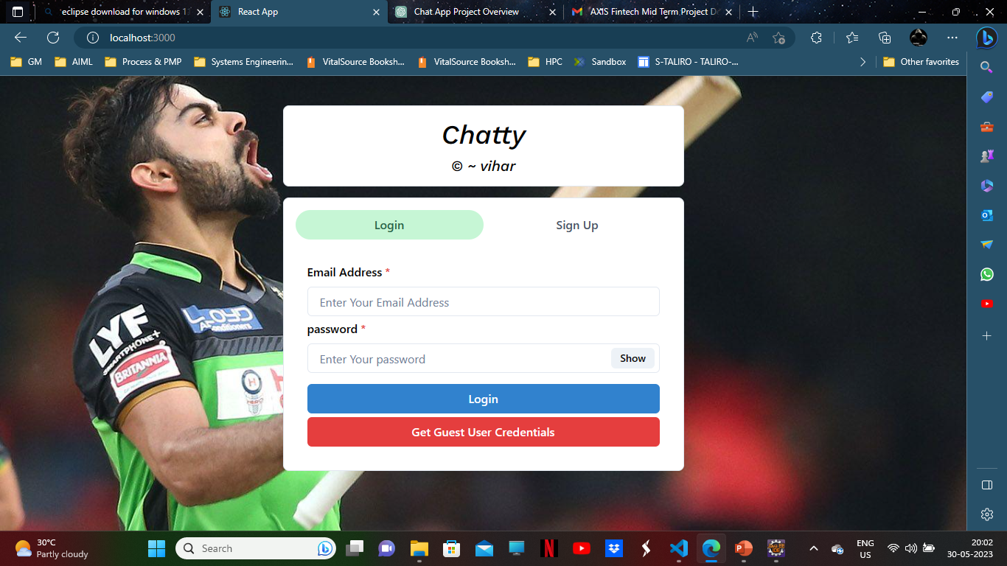

Slide 32
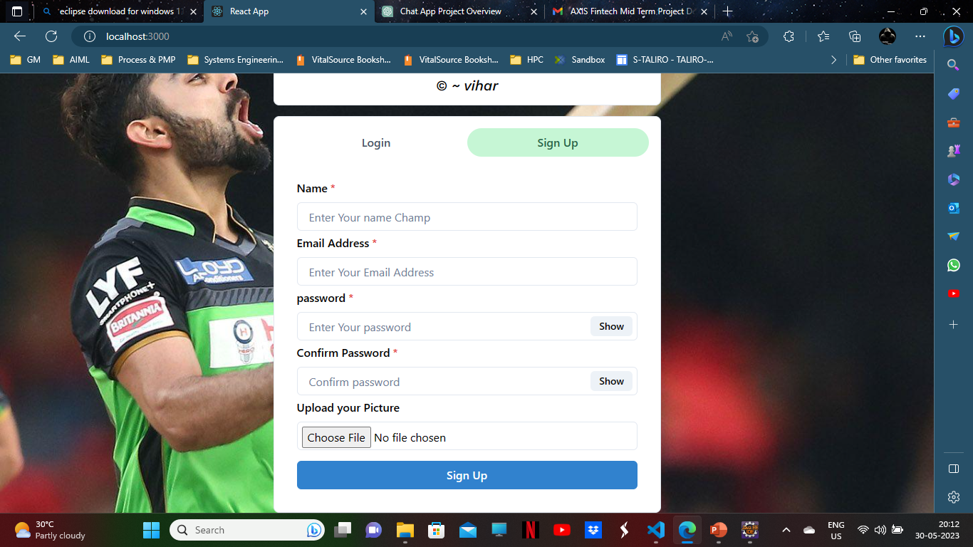

Slide 33
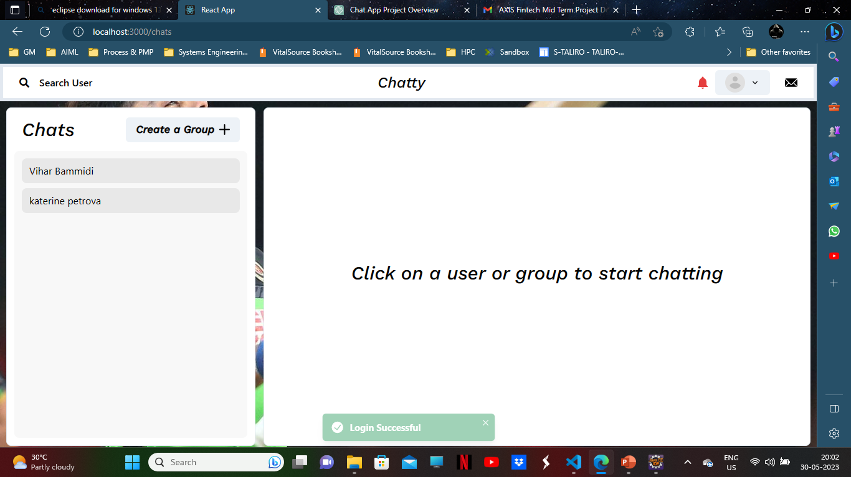

Slide 34
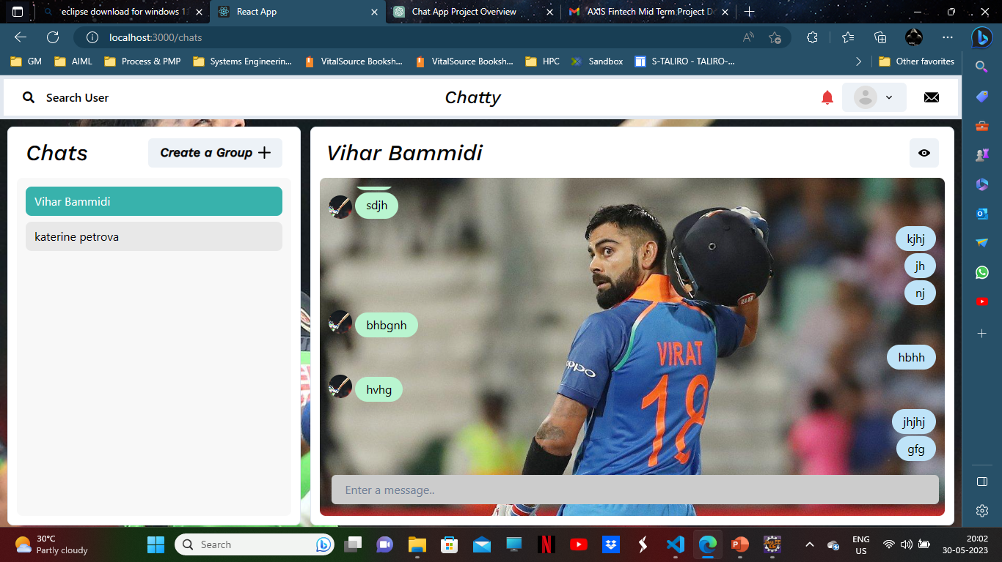

Slide 35
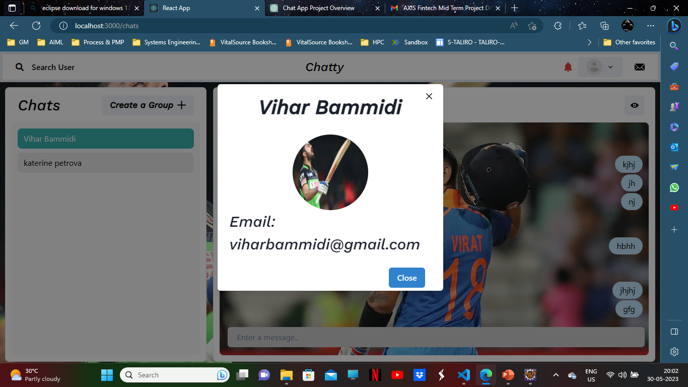

Slide 36
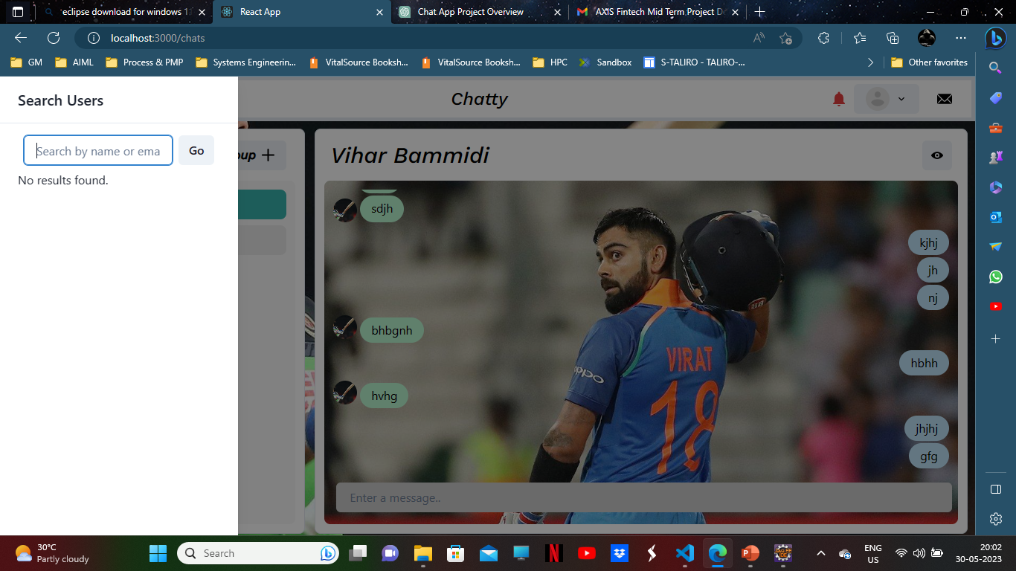

Slide 37

Thank you

